Slide 1

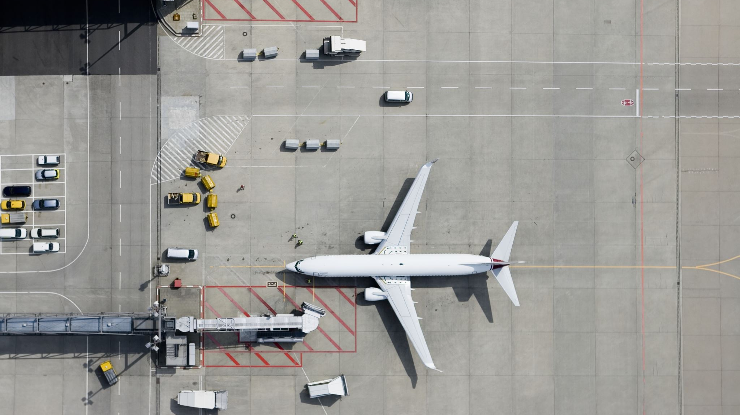
Safety in the Airline Industry
Steven Miller

Slide 2
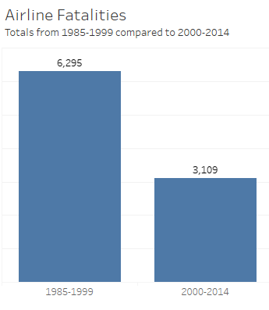
The number of airline fatalities has been cut in half between 1985 and 2014

Slide 3
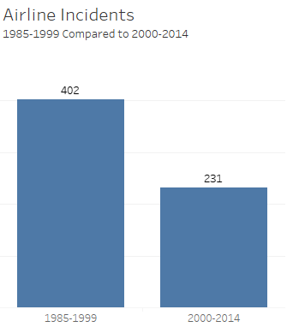
The number of airline incidents has similarly been cut in half between 1985 and 2014

Slide 4
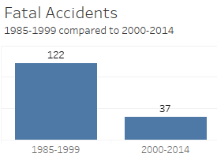
The number of fatal accidents has been reduced by nearly 75%.

Slide 5
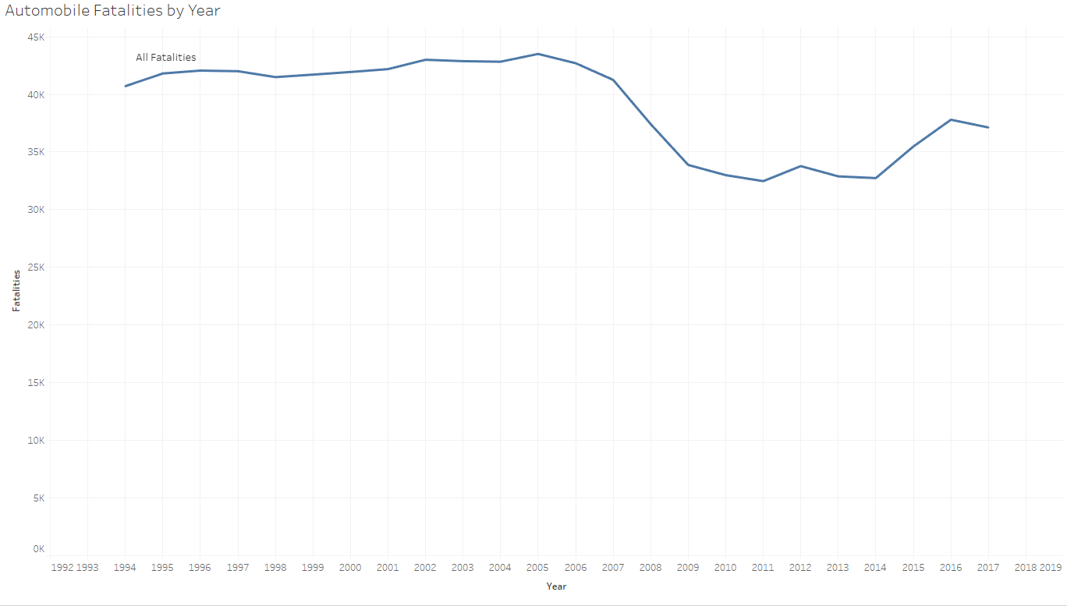
While airline fatalities have been on the decline, automotive fatalities have remained stady.

Slide 6
Air Travel: Safer Than Walking
 | Fatalities 2000-2014
Airline Travel | 3,109
Automobile Travel | 576,546
Pedestrians Killed By Automobiles | 70,139
Motorcyclist Fatalities | 64,894

Slide 7
Conclusion
Airline travel has become safer over the past 35 years.
Incidents and fatalities have both decreased to a fraction of their previous values.
Despite numerous advances in safety technology, automotive fatalities have kept a steady pace over the past 15 years.
More people are killed by automobiles as pedestrians than are killed in airline crashes.
Their infrequent nature makes airplane crashes a bigger story when they do occur, leading to the public perceiving air travel as riskier than it truly is.
In reality, they’re engaging in a riskier activity every time they commute to work, even if they walk!

